Slide 1
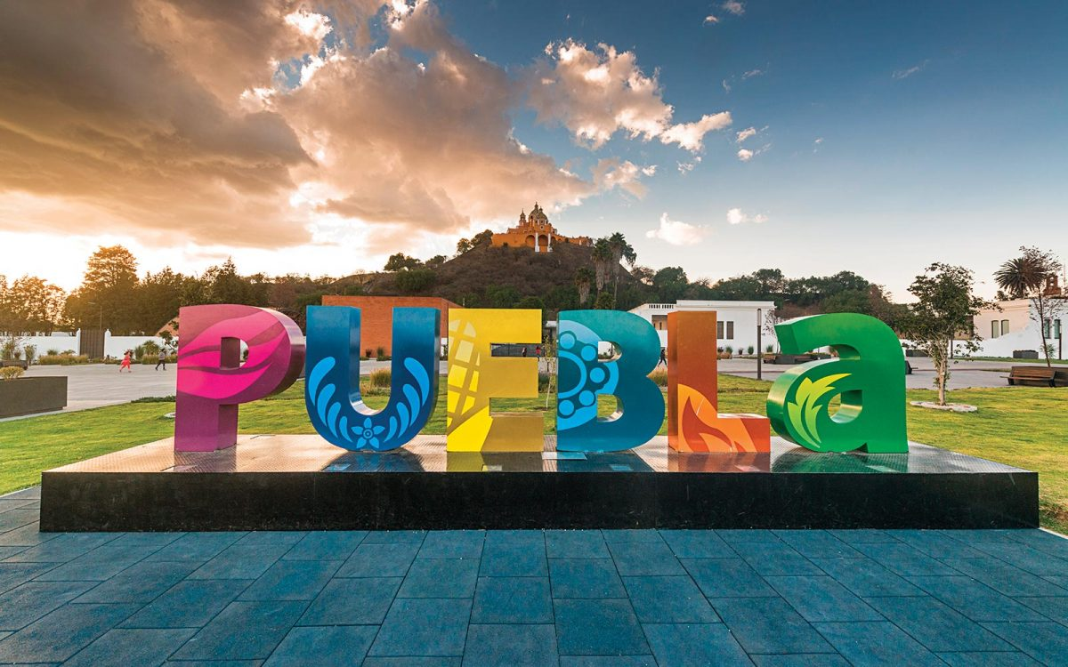
Aplicación de información turística de Puebla

Slide 2
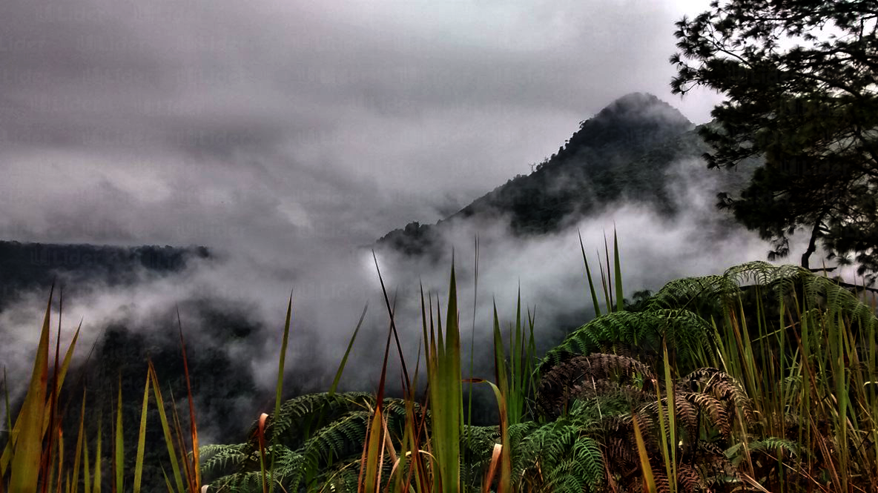
Objetivo
APLICACIÓN WEB
Buscar y consular una agenda de eventos turísticos y culturales.
Ofertados en los distintos recintos de la capital.
Además de los eventos en los atractivos turísticos mas importantes del estado.

Slide 3
Objetivo
APLICACIÓN WEB
Ambiente amigable.
Eventos

Slide 4
Objetivo
Buscar y consular una agenda de eventos turísticos y culturales.
Ofertados en los distintos recintos de la capital.
Además de los eventos en los atractivos turísticos mas importantes del estado.

Slide 5
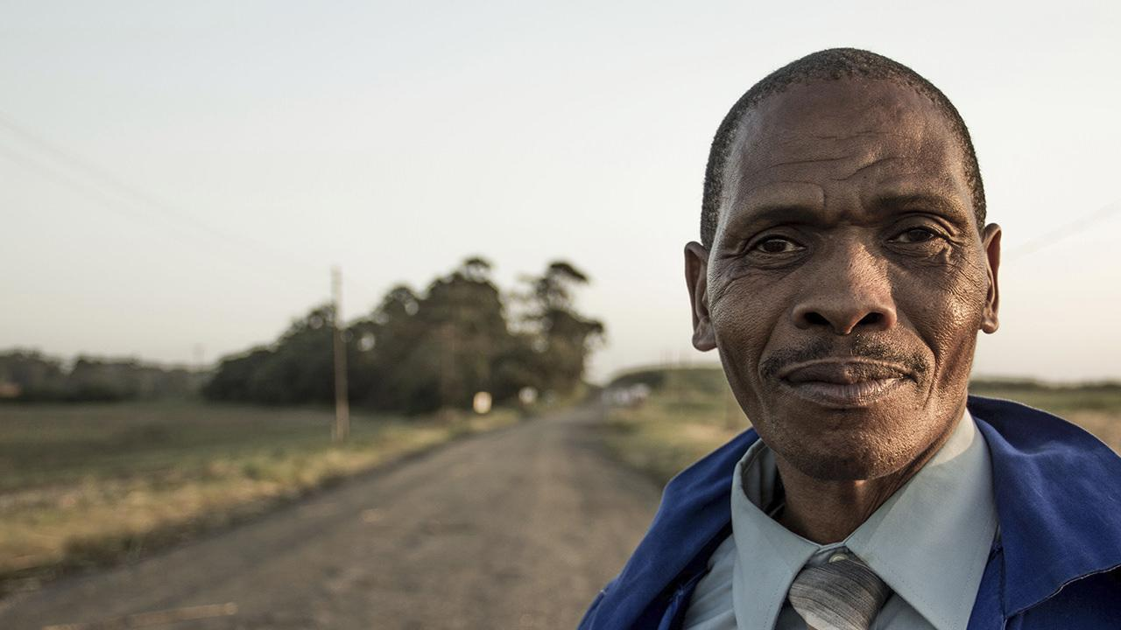
HELLO!
I am Jayden Smith
I am here because I love to give presentations.
You can find me at @username

Slide 6
1.
TRANSITION HEADLINE
Let’s start with the first set of slides

Slide 7
Quotations are commonly printed as a means of inspiration and to invoke philosophical thoughts from the reader.

Slide 8
THIS IS A SLIDE TITLE
Here you have a list of items
And some text
But remember not to overload your slides with content
Your audience will listen to you or read the content, but won’t do both.

Slide 9
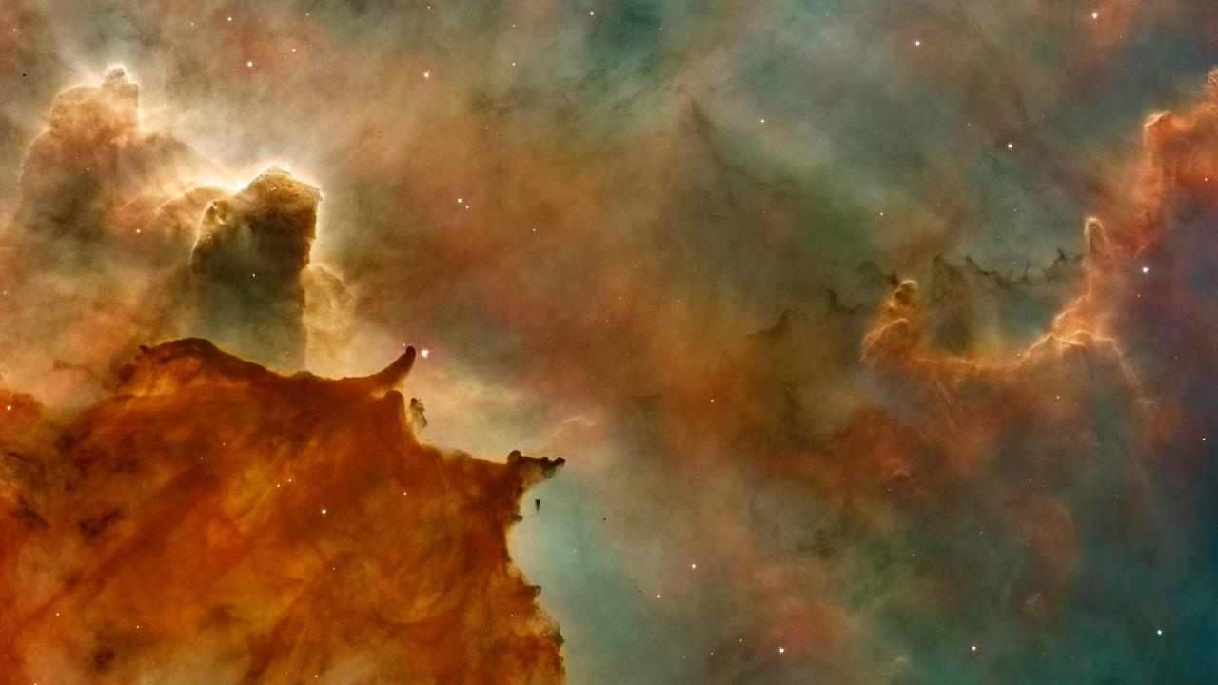
BIG CONCEPT
Bring the attention of your audience over a key concept using icons or illustrations

Slide 10
YOU CAN ALSO SPLIT YOUR CONTENT
White
Is the color of milk and fresh snow, the color produced by the combination of all the colors of the visible spectrum.
Black
Is the color of coal, ebony, and of outer space. It is the darkest color, the result of the absence of or complete absorption of light.

Slide 11
IN TWO OR THREE COLUMNS
Yellow
Is the color of gold, butter and ripe lemons. In the spectrum of visible light, yellow is found between green and orange.
Blue
Is the colour of the clear sky and the deep sea. It is located between violet and green on the optical spectrum.
Red
Is the color of blood, and because of this it has historically been associated with sacrifice, danger and courage.

Slide 12
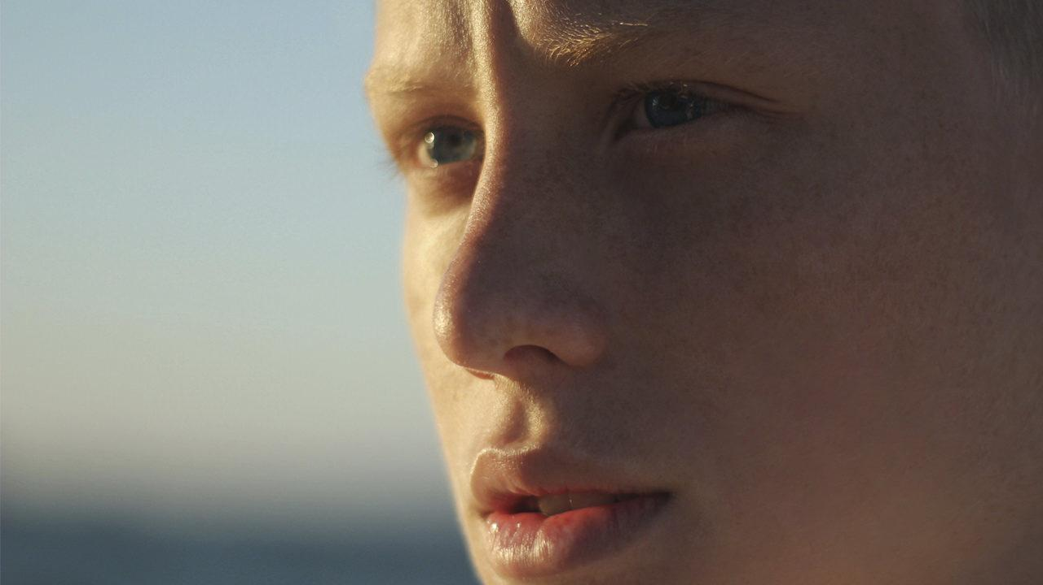
A PICTURE IS WORTH A THOUSAND WORDS
A complex idea can be conveyed with just a single still image, namely making it possible to absorb large amounts of data quickly.

Slide 13
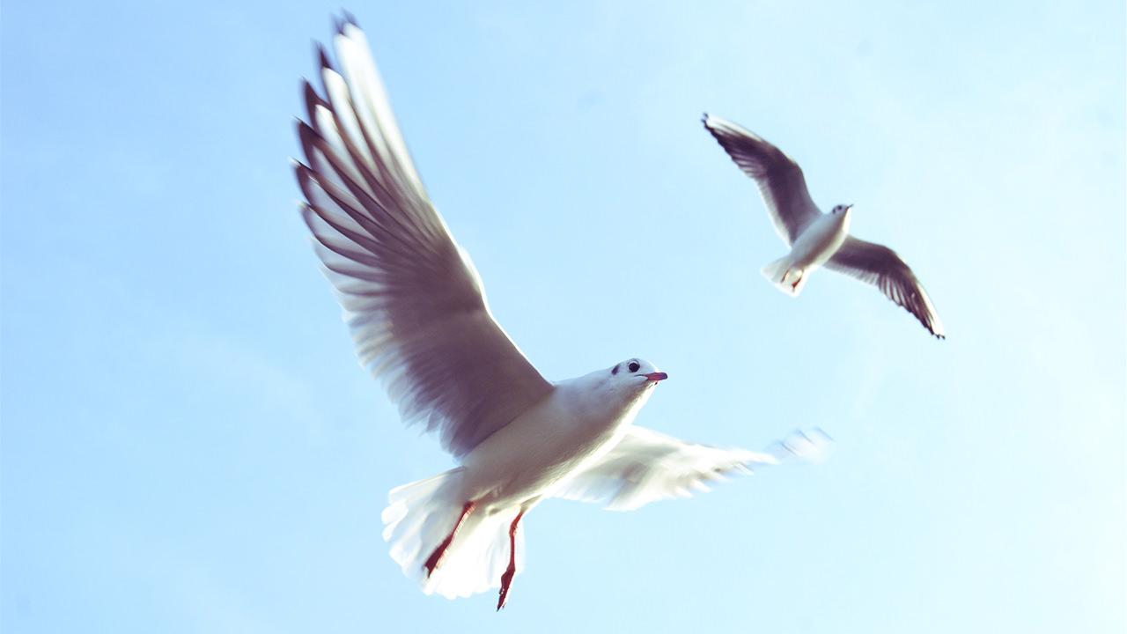
WANT BIG IMPACT?
USE BIG IMAGE

Slide 14
USE CHARTS TO EXPLAIN YOUR IDEAS
White
Black
Gray

Slide 15
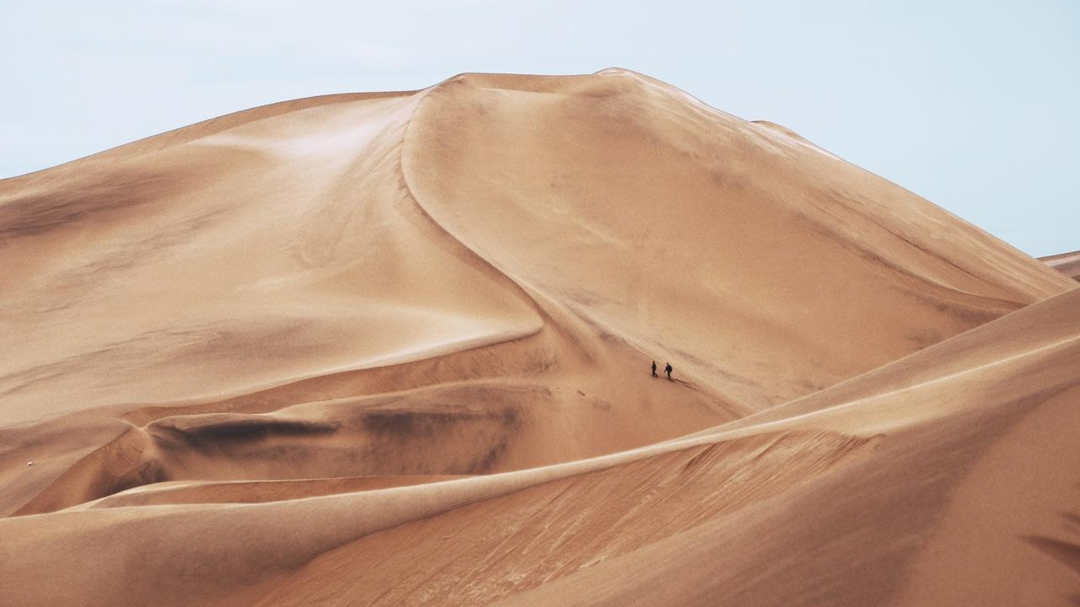
AND TABLES TO COMPARE DATA
 | A | B | C
Yellow | 10 | 20 | 7
Blue | 30 | 15 | 10
Orange | 5 | 24 | 16

Slide 16
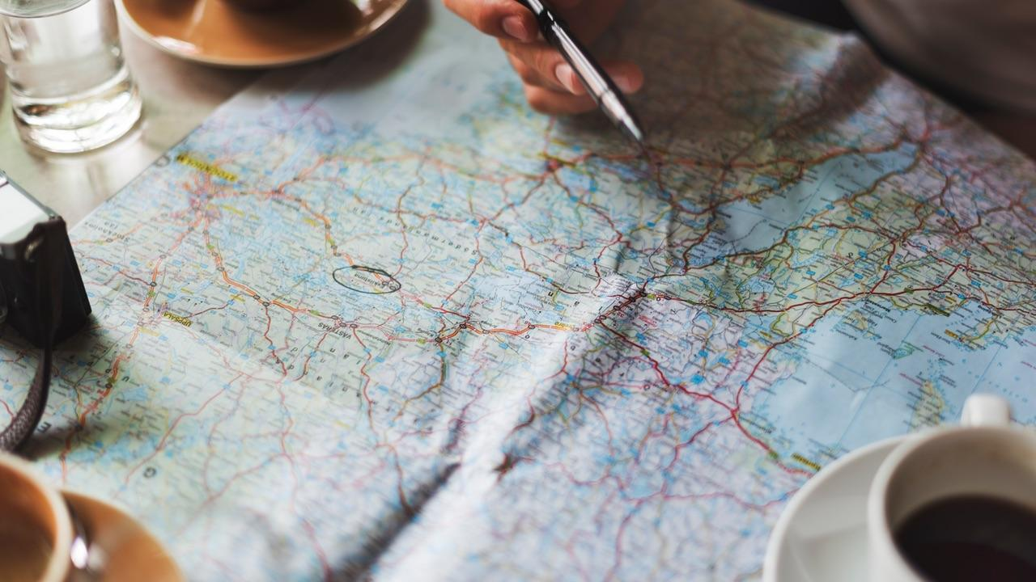
MAPS
our office

Slide 17
89,526,124
Whoa! That’s a big number, aren’t you proud?

Slide 18
89,526,124$
185,244 users
100%
That’s a lot of money
And a lot of users
Total success!

Slide 19
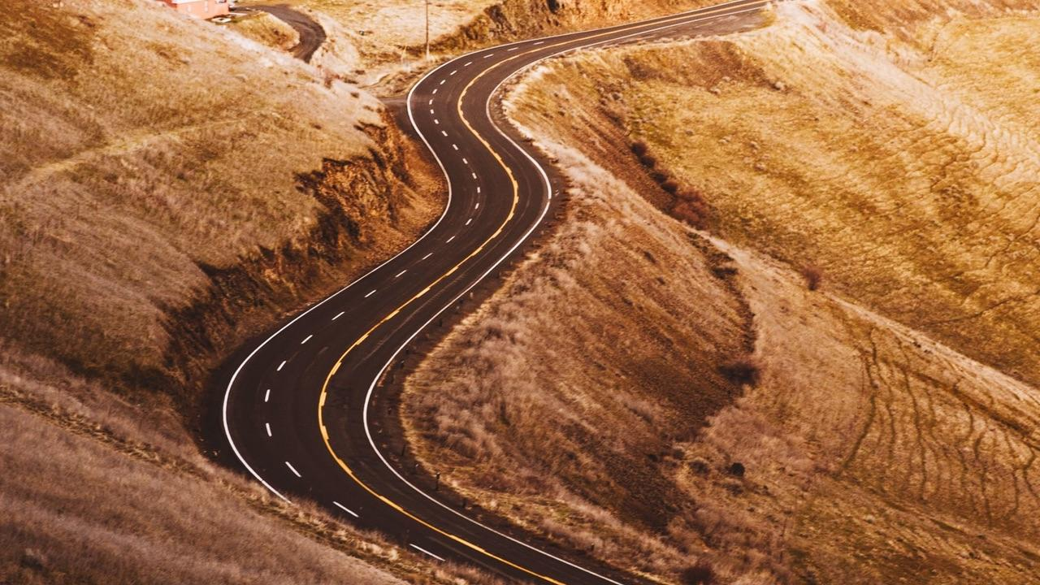
LET’S REVIEW SOME CONCEPTS
Yellow
Is the color of gold, butter and ripe lemons. In the spectrum of visible light, yellow is found between green and orange.
Blue
Is the colour of the clear sky and the deep sea. It is located between violet and green on the optical spectrum.
Red
Is the color of blood, and because of this it has historically been associated with sacrifice, danger and courage.
Yellow
Is the color of gold, butter and ripe lemons. In the spectrum of visible light, yellow is found between green and orange.
Blue
Is the colour of the clear sky and the deep sea. It is located between violet and green on the optical spectrum.
Red
Is the color of blood, and because of this it has historically been associated with sacrifice, danger and courage.

Slide 20
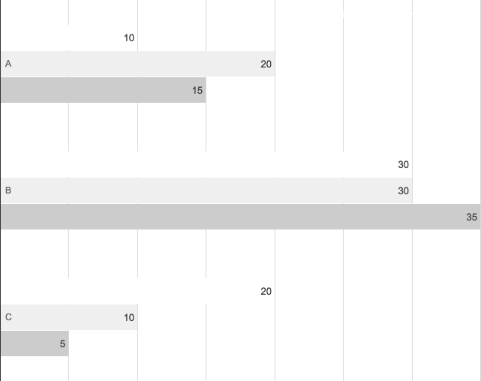
You can insert graphs from Google Sheets

Slide 21

ANDROID
PROJECT
Place your screenshot here
Show and explain your web, app or software projects using these gadget templates.

Slide 22
iPHONE
PROJECT
Place your screenshot here
Show and explain your web, app or software projects using these gadget templates.

Slide 23
TABLET
PROJECT
Place your screenshot here
Show and explain your web, app or software projects using these gadget templates.

Slide 24
DESKTOP
PROJECT
Place your screenshot here
Show and explain your web, app or software projects using these gadget templates.

Slide 25
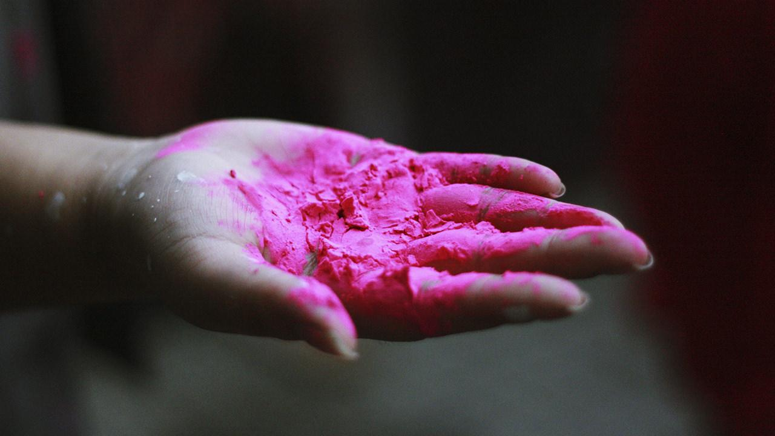
THANKS!
Any questions?
You can find me at
@username
user@mail.me

Slide 26

CREDITS
Special thanks to all the people who made and released these awesome resources for free:
Presentation template by SlidesCarnival
Photographs by Unsplash

Slide 27
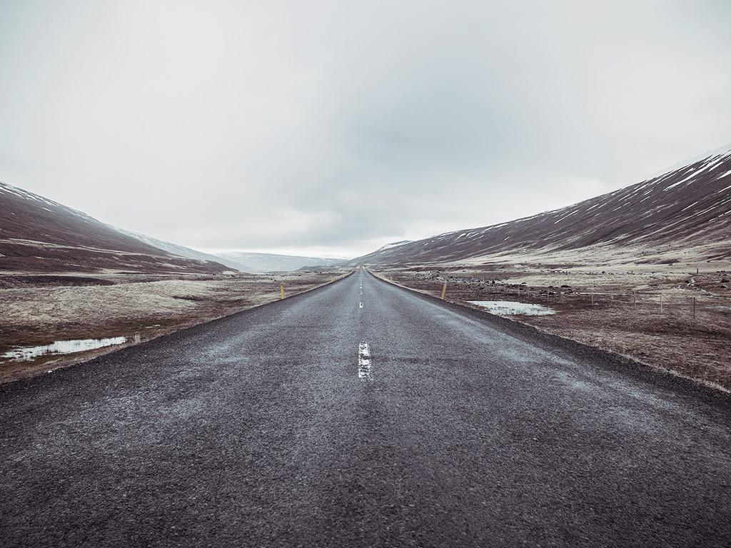
PRESENTATION DESIGN
This presentation uses the following typographies:
Titles: Raleway
Body copy: Varela
You can download the fonts on these pages:
https://www.fontsquirrel.com/fonts/raleway
https://www.fontsquirrel.com/fonts/varela
You don’t need to keep this slide in your presentation. It’s only here to serve you as a design guide if you need to create new slides or download the fonts to edit the presentation in PowerPoint®

Slide 28
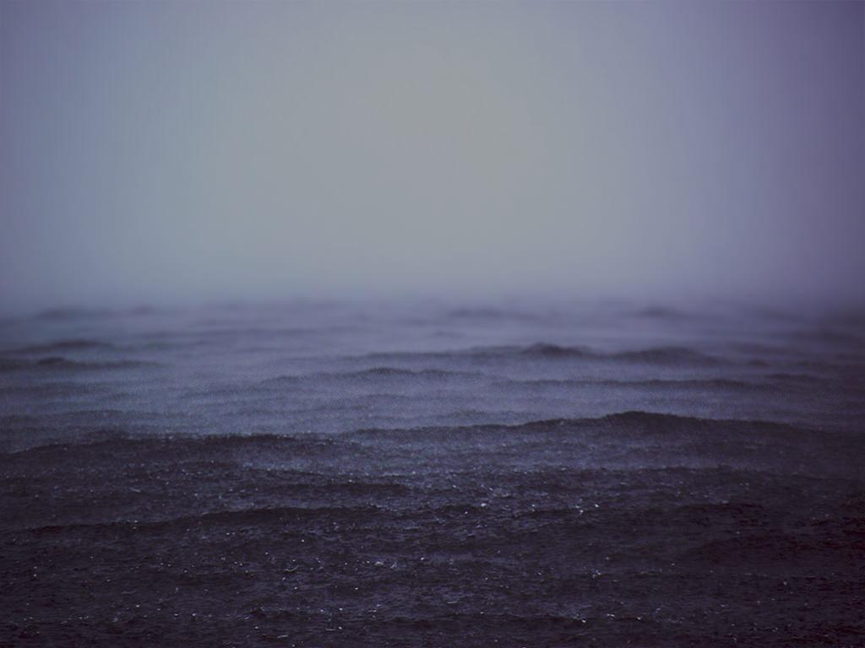
SlidesCarnival icons are editable shapes.
This means that you can:
Resize them without losing quality.
Change line color, width and style.
Isn’t that nice? :)
Examples:

Slide 29
😉
Now you can use any emoji as an icon!
And of course it resizes without losing quality and you can change the color.
How? Follow Google instructions https://twitter.com/googledocs/status/730087240156643328
✋👆👉👍👤👦👧👨👩👪💃🏃💑❤😂😉😋😒😭👶😸🐟🍒🍔💣📌📖🔨🎃🎈🎨🏈🏰🌏🔌🔑 and many more...

